Slide 1
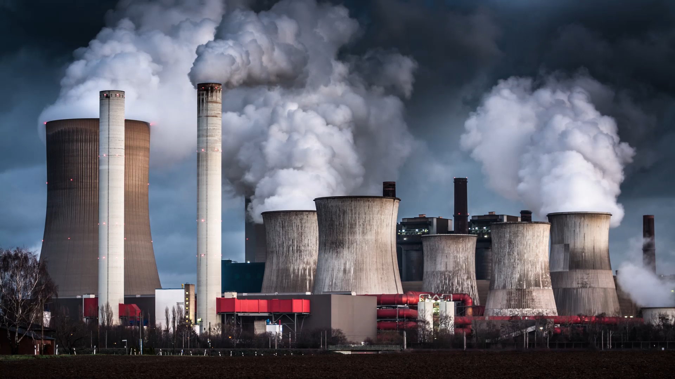
Quality Prediction in a Mining Process
EDA – preprocessing – model - Power bi

Slide 2
Done By: Ahmed Mahmoud Sanad Mohamed Ramadan Under the supervise of: Eng Marwan Ahmed

Slide 3
Dataset ?
This dataset is about a flotation plant which is a process used to concentrate the iron ore. This process is very common in a mining plant.
The target is to predict the % of Silica in the end of the process, which is the concentrate of iron ore and its impurity (which is the % of Silica).
The % of Silica is a lab measurement, which means that it takes at least one hour for the process engineers to have this value. So, if it is possible to predict the amount of impurity in the process
A flotation plant is a critical component in the mining process, allowing for the efficient separation of valuable minerals from the ore. The plant's operations involve several steps, from crushing and grinding the ore to creating a slurry, adding reagents, and separating the valuable minerals in flotation cells. The concentrate is then further refined, while the tailings are managed and disposed of.
Flotation is a critical separation process in the mining industry that allows for the recovery of valuable minerals from ore. By utilizing differences in surface properties and introducing air bubbles, the process enables the concentration of minerals that can be further refined and used in various industrial applications.

Slide 4
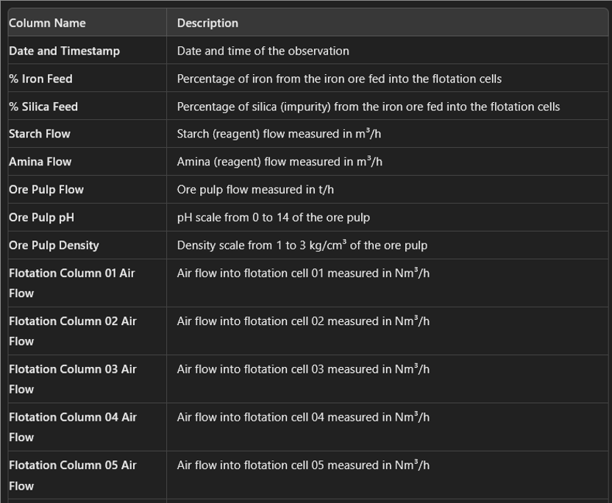

Slide 5
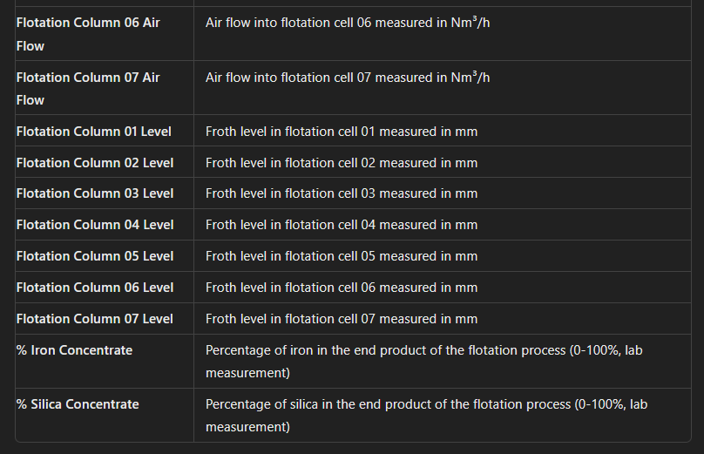

Slide 6
Dataset ?
Mining ➔ is the process of extracting valuable minerals or other geological materials from the Earth. These materials are typically found in ore deposits, veins, seams, or beds and include metals, coal, oil shale, gemstones, limestone, chalk, dimension stone, rock salt, potash, gravel, and clay.
Ore ➔ is the raw material that provides the metals and minerals essential for modern industry, and its extraction and processing are key components of the mining industry. Ores are the raw materials that contain the valuable substances needed for industrial processes, including the production of metals like iron, copper, gold, and aluminum, as well as other minerals.
Pulp ➔ is a mixture of finely ground ore and water, sometimes with added chemicals, that is used in various processes to extract valuable minerals. The properties of the pulp, such as its density and pH, are critical to the efficiency of these processes. It’s an essential intermediate product in the journey from raw ore to refined metals or minerals.
Pulp ➔ is essentially the ore after it has undergone initial processing steps, specifically crushing and grinding, to reduce the ore to fine particles. This pulp is then mixed with water to create a slurry, which can be further processed to extract valuable minerals.

Slide 7
Dataset ?
Amina ➔ This is a type of reagent used in the flotation process. Amines are commonly used as collectors for the flotation of iron ores, where they help to selectively attach to the mineral surfaces.
Starch ➔ Starch is often used as a depressant in the flotation process to prevent certain minerals from floating while allowing others to be recovered.
These chemicals are used to enhance the separation of minerals from the ore.

Slide 8
Dataset ?
Column(6) ➔ Ore Pulp Flow:
This column represents the flow rate of the ore pulp, typically measured in (t/h): (tons/hour).
Importance: Flow rate is crucial for controlling the movement of the pulp through the processing plant. It ensures that the material is processed at the right speed, impacting the efficiency of the separation processes.
Column(7) ➔ Ore Pulp pH:
This column represents the pH level of the ore pulp, indicating its acidity or alkalinity on a scale from 0 to 14.
Importance: The pH level can significantly affect the efficiency of separation processes such as flotation or leaching. Certain minerals respond differently at different pH levels, making this a key factor in optimizing recovery rates.
Column(8) ➔ Ore Pulp Density:
This column represents the density of the ore pulp, measured in (kg/cm³)
Importance: Density provides insight into the concentration of solids in the pulp. A higher density means more solid particles are present, which can influence the effectiveness of separation processes like flotation.
Density scale from 1 to 3 kg/cm³

Slide 9
Dataset ?
The "Flotation Column 01 Air Flow" column represents the air flow rate in the first flotation column, which is essential for creating the bubbles needed for froth flotation. This parameter directly impacts the efficiency and effectiveness of the mineral separation process. Monitoring and adjusting the air flow rate is crucial to ensure optimal operation of the flotation column and maximize mineral recovery.
The "Flotation Column 02 Air Flow" column measures the air flow rate in the second flotation column. This parameter is essential for controlling the flotation process, which separates valuable minerals from the ore. Proper management of air flow ensures that the flotation column operates efficiently, maximizing the recovery of valuable minerals while minimizing waste. Each flotation column may have different air flow requirements depending on the specific conditions and materials being processed.
They are independently controlled and optimized based on the specific requirements of each column and the overall goals of the flotation process. The relationship between them is more likely to be operational or empirical rather than strictly mathematical.

Slide 10
Dataset ?
Flotation Column 01 Level:
Description: This refers to the level of the pulp (mixture of ore and water) within the flotation. It indicates how much of the column is filled with this mixture.
Importance:
Froth Control: The pulp level controls the froth layer thickness at the top of the flotation column. The froth layer is where the separation of valuable minerals occurs, so maintaining the correct level is critical.
Process Stability: The level is crucial for maintaining process stability. If the pulp level is too low, the froth layer might collapse, leading to poor recovery of minerals. If it’s too high, it could lead to excessive froth overflow and loss of valuable material.
Optimization: The level can be adjusted to optimize the recovery and grade of the concentrate.

Slide 11
Dataset ?
Flotation Column 01 Air Flow:
Description: This measures the rate at which air is injected into the flotation column. The air flow rate is typically measured in units like cubic meters per hour (m³/h) or liters per second (L/s).
Importance:
Bubble Formation: The air flow creates bubbles that attach to the hydrophobic mineral particles, allowing them to rise to the surface and form a froth.
Separation Efficiency: Proper control of air flow is essential for generating the right size and number of bubbles. Too much air can create too many bubbles, which might carry impurities, while too little air might not produce enough bubbles for effective separation.
Operational Control: The air flow rate is adjusted based on the type of ore being processed and the desired outcome (e.g., maximizing recovery or purity).
is measured in Nm³/h (Normal cubic meters per hour), it indicates the volumetric flow rate of air supplied to the flotation
Air Flow: refers to the volume of air introduced into the flotation. Air is crucial in the flotation process as it helps to create bubbles that attach to the mineral particles, allowing them to rise to the surface and be separated from the ore pulp.

Slide 12
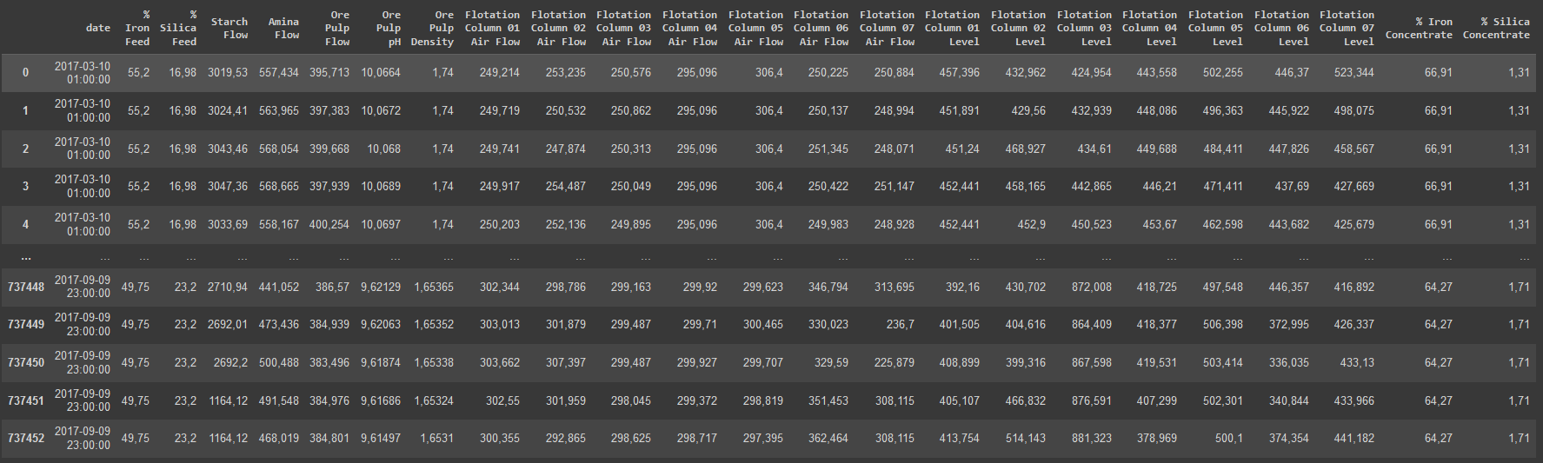
EDA
Commas Problem

Slide 13
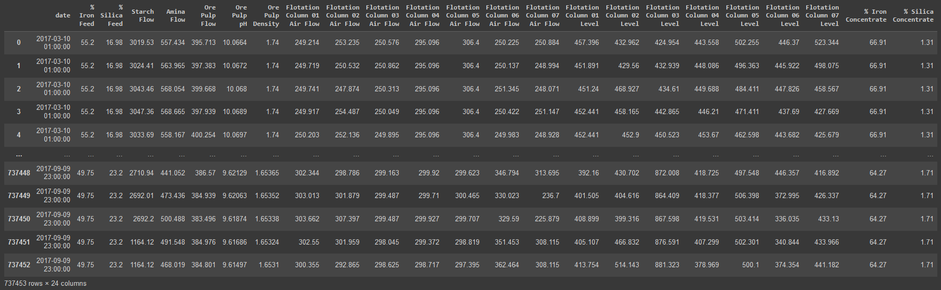
EDA
Commas to dots

Slide 14
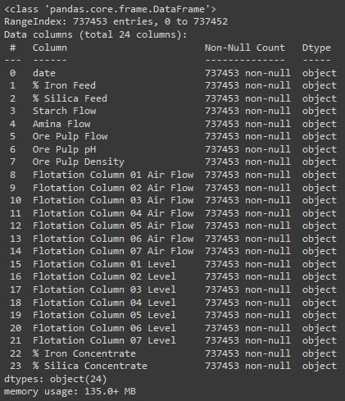
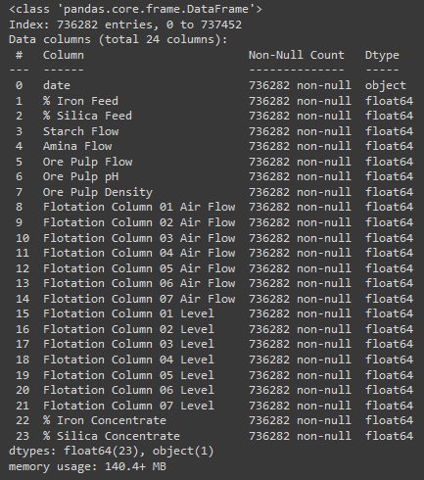
EDA
Objects to float

Slide 15
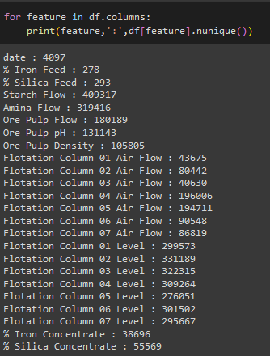
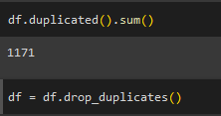
EDA
Drop duplicated Columns

Slide 16
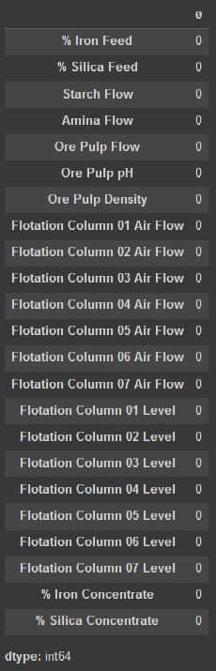
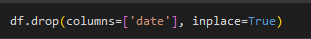
EDA
Drop date column & check nulls

Slide 17
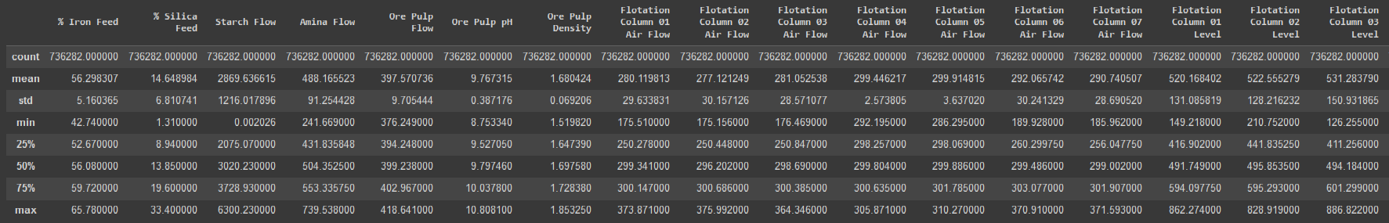
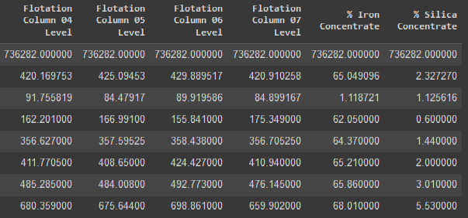
Handling Outliers

Slide 18
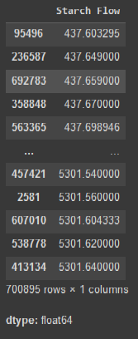
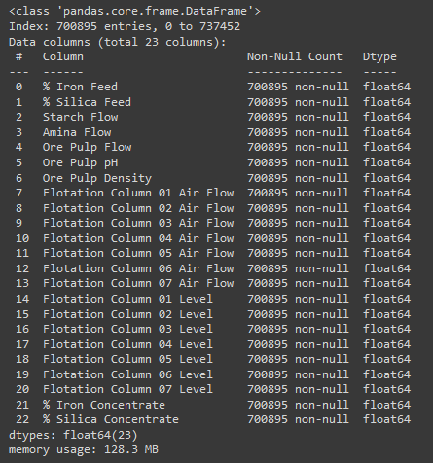
Handling Outliers
Using z-score
'Starch Flow’
< 2 std
➔
700895 rows

Slide 19
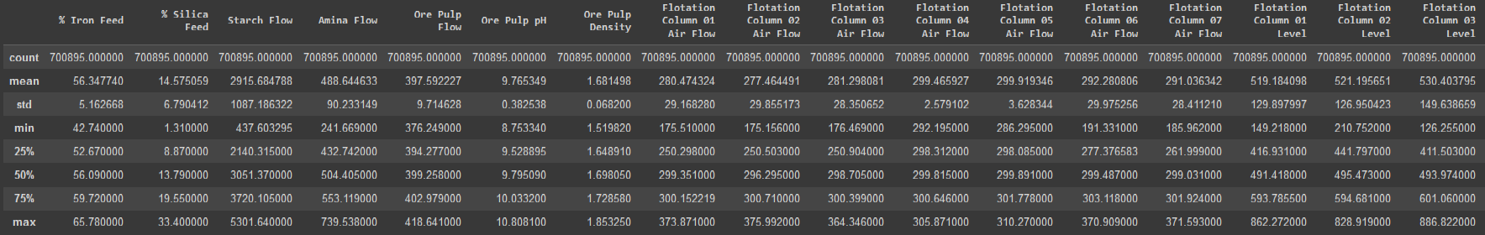
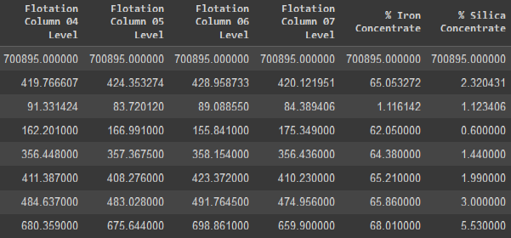
Handling Outliers

Slide 20
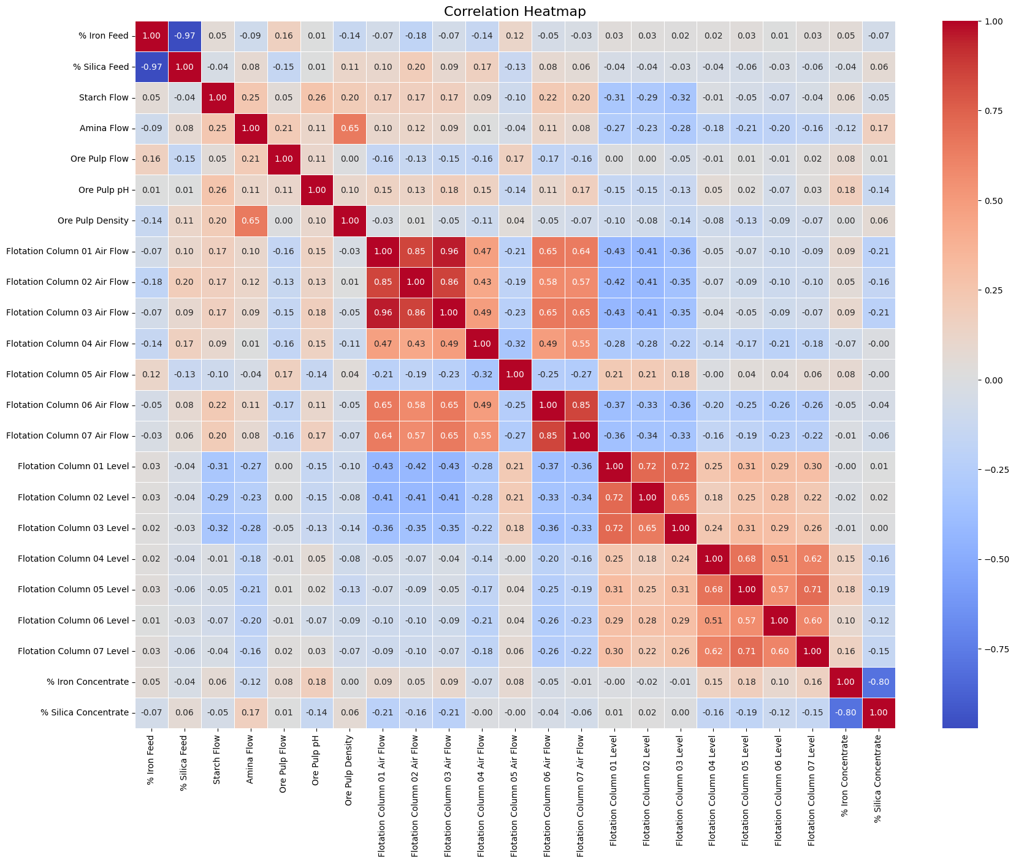
Correlation

Slide 21
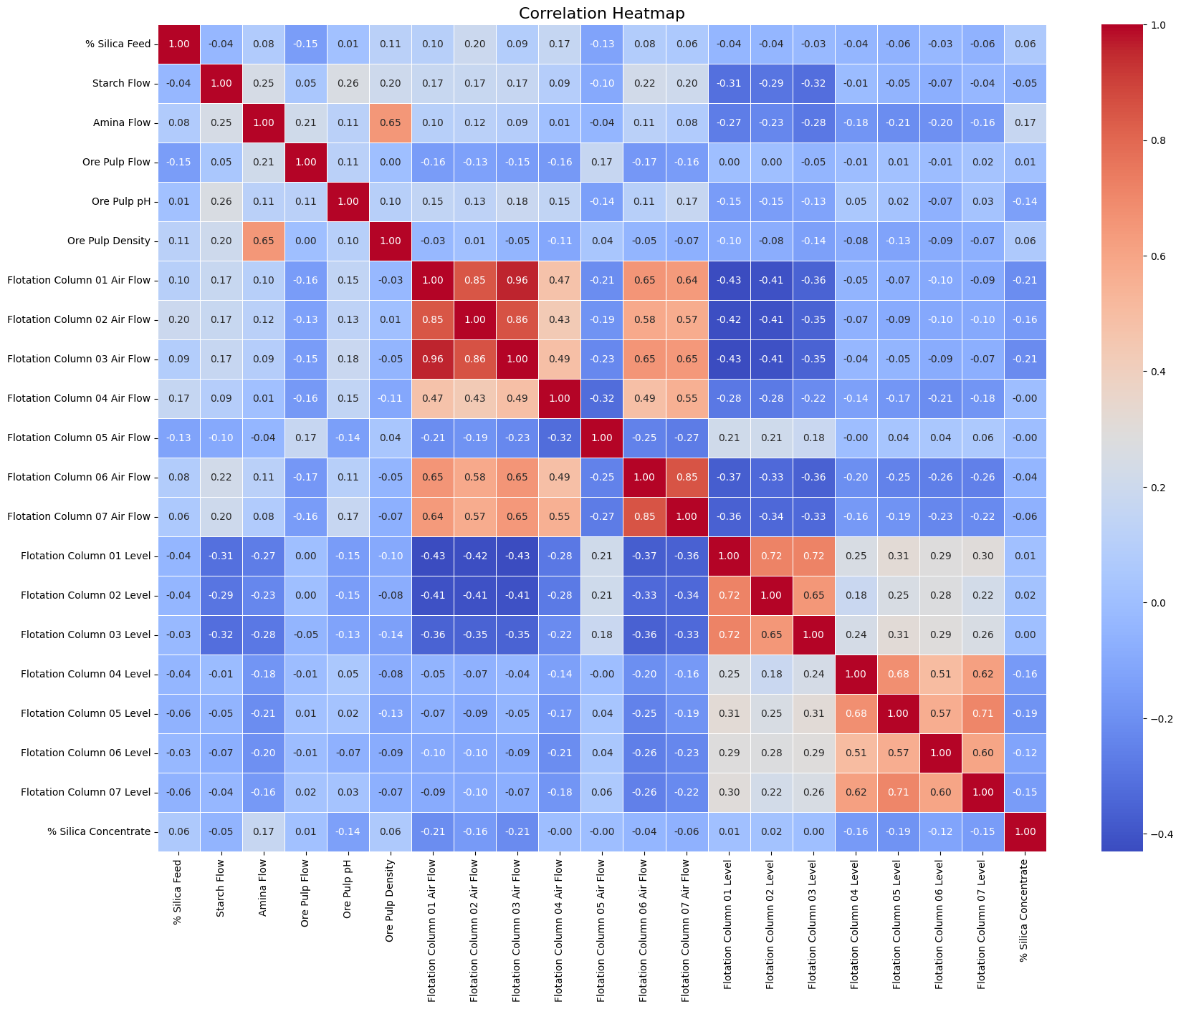
Correlation
Dropping ‘% Iron Concentrate’ column => an output of laboratory analysis => highly correlated to %Silica.
Dropping ‘% Iron Feed’ => highly correlated to % Silica feed

Slide 22
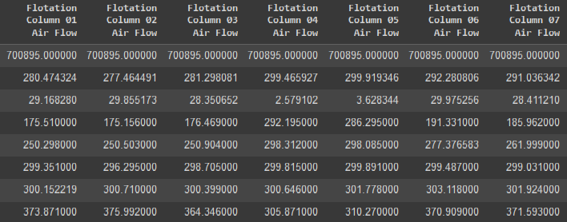
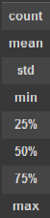
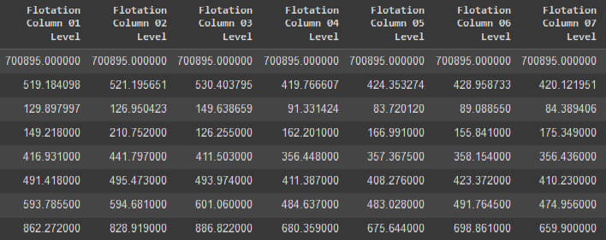
Correlation Analysis
Combine air flow columns based on the mean to a new column ➔ ‘avg_air_flow’
Combine levels columns based on the mean to a new column ➔ ‘avg_level’
Dropping all other 14 columns.

Slide 23
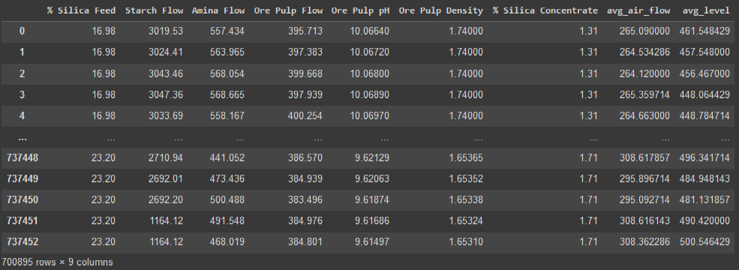
Correlation Analysis

Slide 24
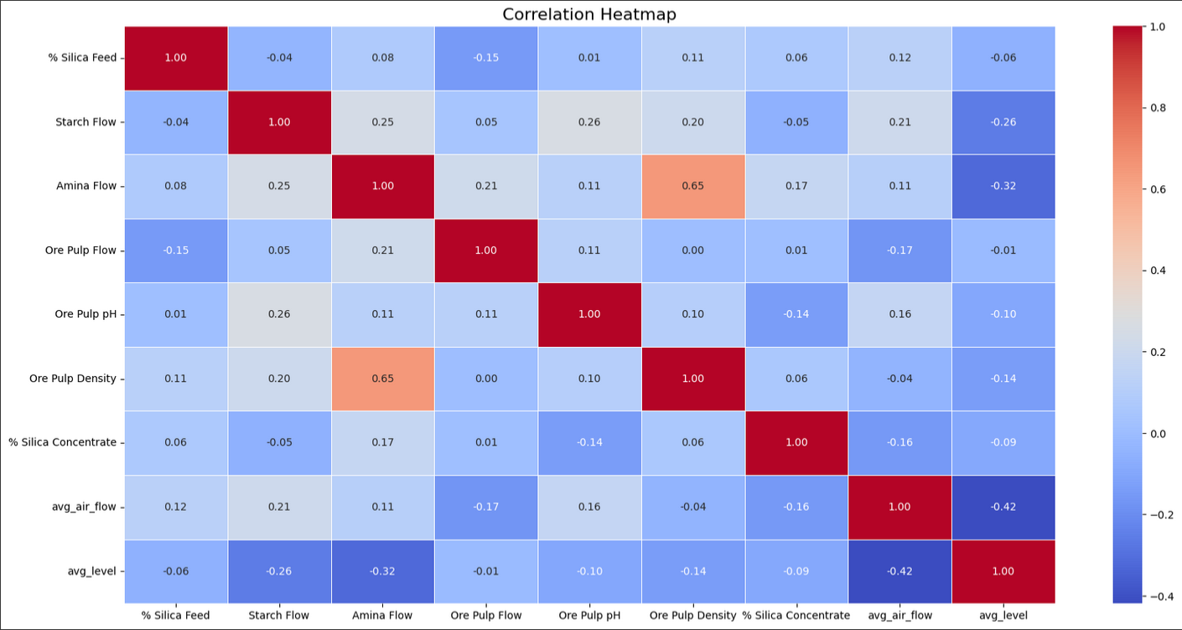
EDA Steps ?

Slide 25
Models
Decision Tree:
Mean Squared Error: 0.15201567258235718
R-squared: 0.8791712406928346
Random Forest:
Mean Squared Error: 0.0617633367077262
R-squared: 0.9509077766897872

